Slide 1
Electromagnetic Radiation
Chapter 8.2

Slide 2
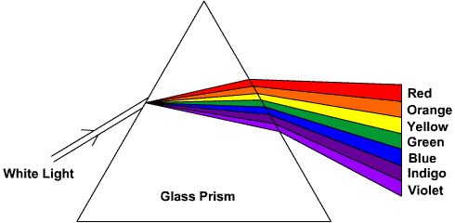
The Nature of Light
Light in a vacuum (i.e. space) has a velocity of 299,792 km/s.
Newton passed a beam of light through a prism and produced a spectrum of myriad color and seen in a rainbow.

Slide 3
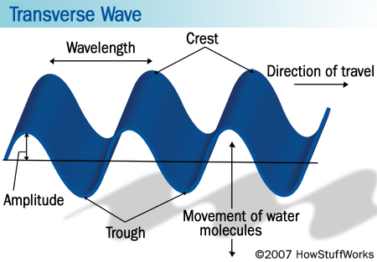
Characteristics of Waves
The distance between two consecutive waves crests or wave troughs is called wavelength, λ (Greek letter lambda), and is measured in meters (m).

Slide 4
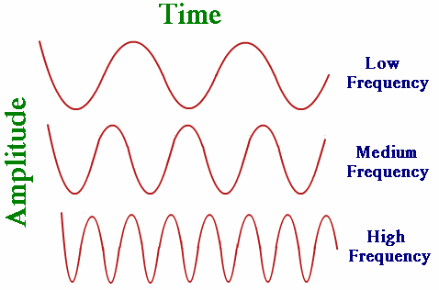
Characteristics of Waves
The number of wave crests that pass a specific point per second is the frequency, f, and is measured in Hertz (Hz)

Slide 5
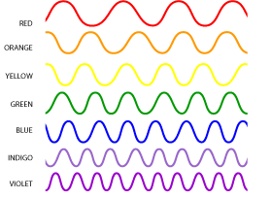
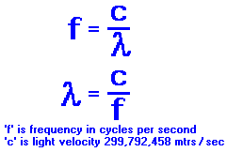
Light as a Wave
The speed of light can be calculated using the wavelength (ʎ) and frequency (f).
$$c=ʎf$$

Slide 6
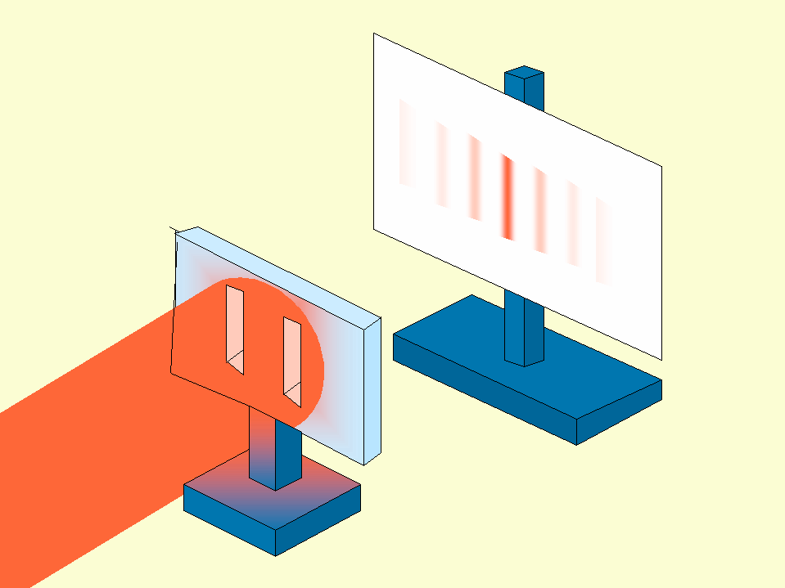
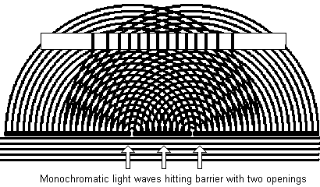
Dual-Slit Experiment
English physicist Thomas Young shined a monochromatic, or “one color”, light through a pair of slits.
Projected on the wall were a pattern of light and dark fringes.
This can only be explained if light is a wave.

Slide 7
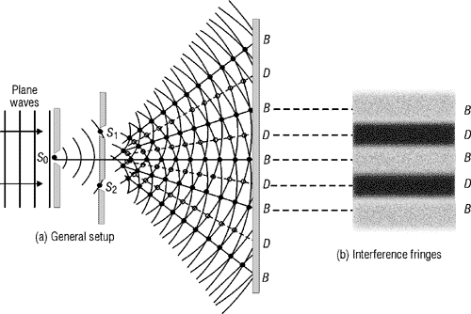
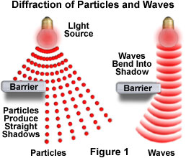
Light as a Wave
In Young’s experiment, the slits acted as a new source of waves, spreading light into dark areas.
This phenomenon is called diffraction.
The waves emanating from the slits interfere with one another.

Slide 8
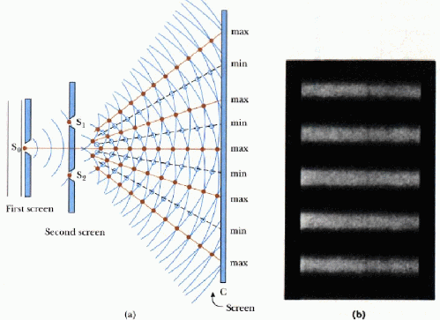
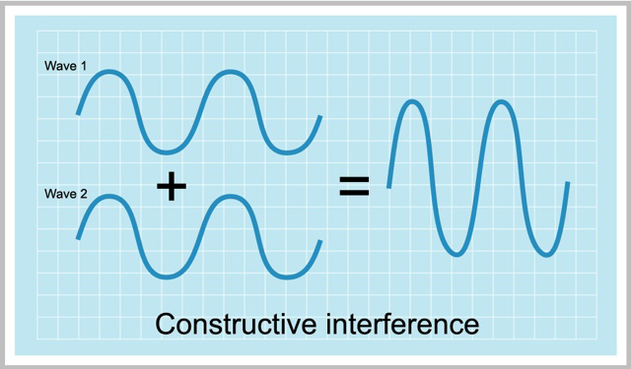
Light as a Wave
Waves comes together in constructive interference to make a bright central fringe.
The distance to the next bright fringe is exactly one wavelength.

Slide 9
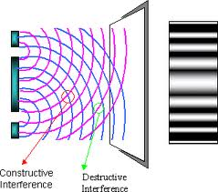
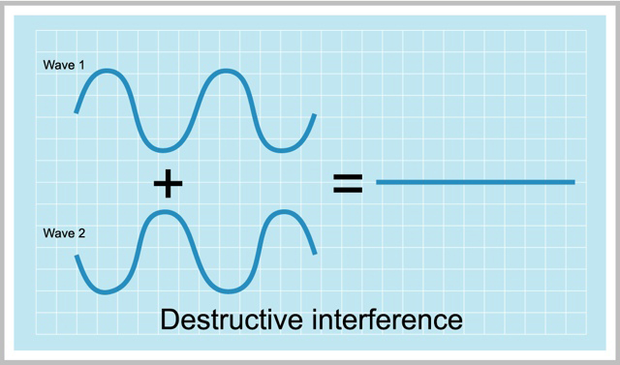
Light as a Wave
When the crest of one wave meets the trough of another wave the waves cancel out and forms a dark fringe.
This phenomenon is called destructive interference.

Slide 10
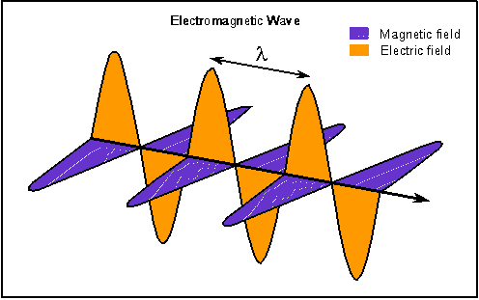
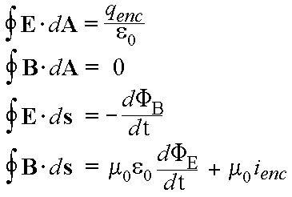
Light as a Wave
Maxwell (1860’s) revealed the nature of light and formulated four basic equations that describe electric and magnetic fields.
He showed that these waves move at 3 x 10⁸ m/s in a vacuum.
Identified light as an electromagnetic wave, or electromagnetic radiation, but does not need a medium to travel through.

Slide 11
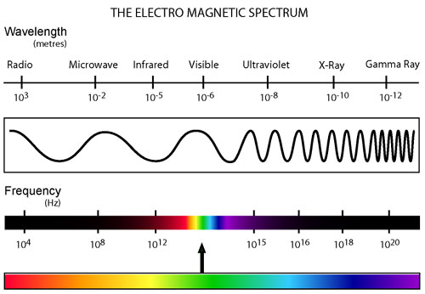
The Electromagnetic Spectrum
The full array of wavelengths and frequencies of electromagnetic waves is called the electromagnetic spectrum.

Slide 12
The Electromagnetic Spectrum
The most familiar domain is visible light, or optical radiation, which is made up of relatively short waves.
The human eye is sensitive to wavelengths between about 4 x 10⁻⁷ to 7 x 10⁻⁷ meters.
These number are small so it is convenient to use a unit called the Angstrom (Å), which is about 10⁻¹⁰ meters or the diameter of an atom.

Slide 13
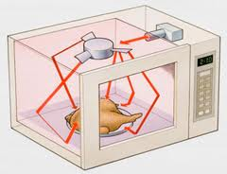
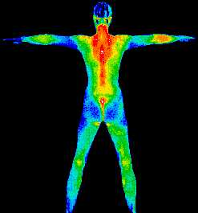
The Electromagnetic Spectrum
Infrared radiation, which has a wavelength around a tenth of millimeter, is felt as heat.
Wavelengths between perhaps a millimeter and a few centimeters, with frequencies of billions of Hertz (gigaHertz, GHz), are called microwaves.

Slide 14
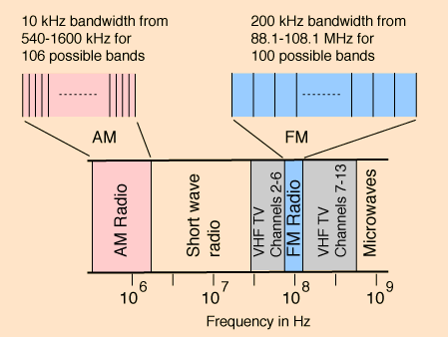
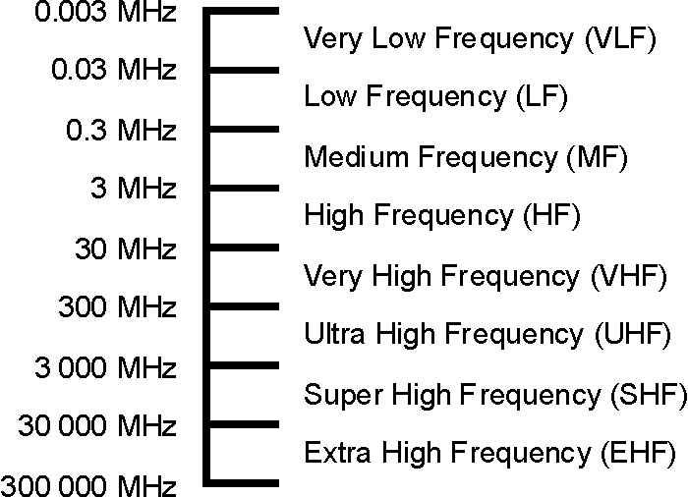
The Electromagnetic Spectrum
Proceeding to longer wavelengths are radio waves with sub regions.
Televisions and FM radio are broadcast at millions of Hertz (megaHertz, MHz) with wavelengths of a few centimeters to a few meters.
AM radio has lower frequencies in the thousands of Hertz (kiloHertz, kHz) with wavelengths of about 1 km.

Slide 15
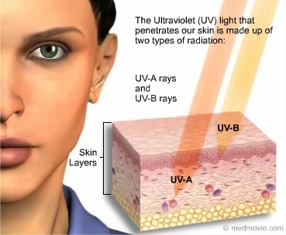
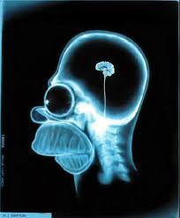
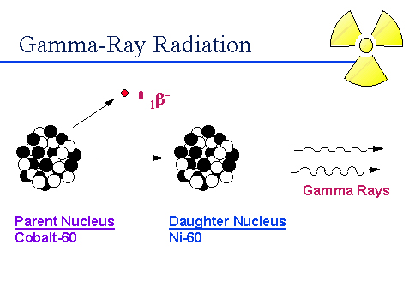
The Electromagnetic Spectrum
Ultraviolet (UV) radiation extends from the near ultraviolet at about 4,000 Å downward to the far ultraviolet of about 100 Å.
At this point it becomes known as X rays.
Below about one Ångstrom are gamma rays produced by atomic decay.

Slide 16
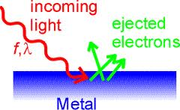
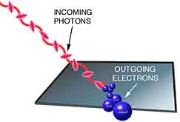
Photons and Energy
In Young’s experiments, as well as others, wave theory is confirmed, yet in other experiments it completely fails.
An example of this is the photoelectric effect, in which a beam of light knocks electrons loose from a substance to produce a flow of electricity.

Slide 17
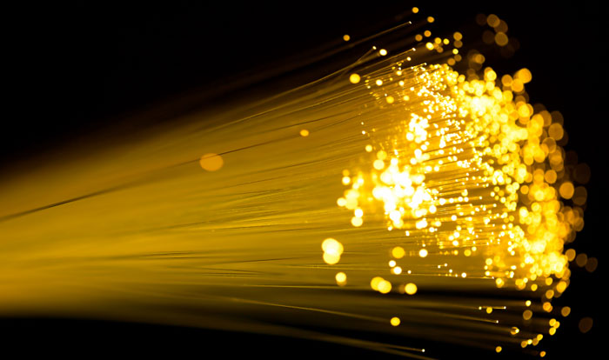
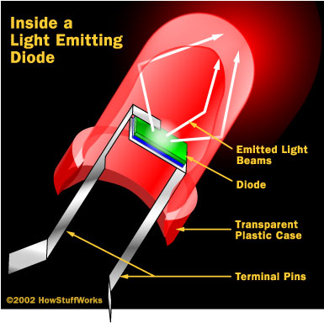
Photons and Energy
Light acts like both a wave and a particle, at the same time!
The particle of light, the photon, is a packet or quantum of energy with an underlying wave nature.
Each photon carries an amount of energy, E, that depends upon its frequency, f, where
$$E=hf$$
And h (Planck’s constant) is $6.63x{10}^{−34} joule seconds$

